Slide 1
Dementia Friendly 18
Bailey Rustad and Anne Gradoville

Slide 2
Introduction to Problem

Slide 3
How We Got the Idea
Athletic Department 21 Day Racial Equity Habit Building Challenge
Accessible
Student friendly
Very informative

Slide 4
Why Is This Beneficial?
Lack of knowledge regarding dementia in our communities
More people will say yes to this than 3 hour trainings
We are all connected to dementia somehow

Slide 5
Research Questions
How can we increase people’s awareness about dementia?
Can we increase people’s knowledge of dementia through them receiving an email for 18 days that has about 10 minutes of information to read and watch each day?

Slide 6
Goals

Slide 7
Goal
To increase people’s knowledge about dementia
Will help make the community more dementia friendly
We also want to learn more ourselves!
Dementia Knowledge
Dementia Friendly

Slide 8
Method

Slide 9
Design and Process
Developed topics for 18 days
Found resources for each topic
Personal stories and factual knowledge

Slide 10
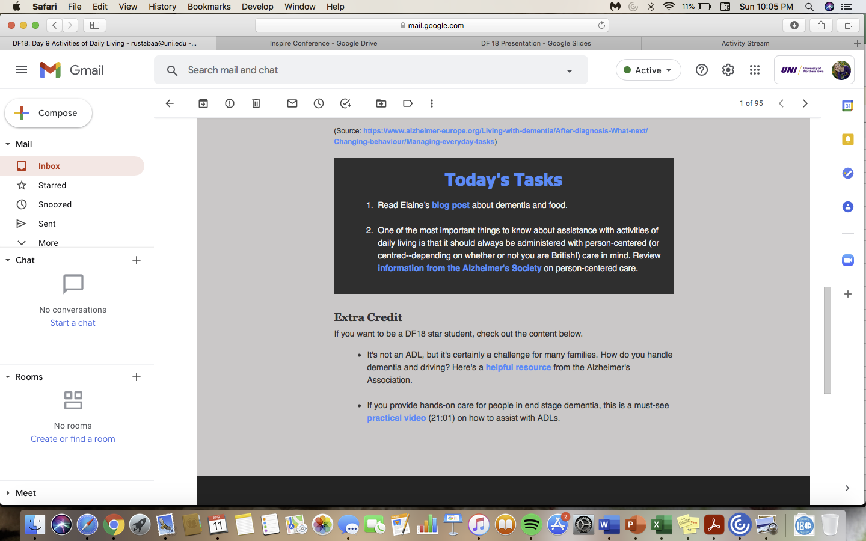
Example Newsletter

Slide 11
First Group
“Trial run”
Family and friends
30 participants
3 students
6 UNI faculty and staff members
5 individuals working in healthcare full-time
Other various occupations
Law enforcement, marketing manager, produce manager, etc.
Over half of participants had connections to individuals with dementia

Slide 12
Second Group
Focused on students on campus
67 participants
Majority are undergraduate students
Communication sciences and disorders, gerontology, social work, biology, exercise science, psychology
79% know or have known someone with dementia
79% currently work with or will work with individuals living with dementia in their career

Slide 13
Assessing DF18
Pre and post-test sent to all participants
Demographic questions
Questions assessing dementia knowledge (true/false)
After first trial, had a focus group with several participants to collect qualitative data

Slide 14
Results

Slide 15
Pre-Test Statistics (First Group)
30 respondents
3/27 questions 100% correct
Top three most difficult questions:
White Americans are more likely to have dementia than black Americans (FALSE).
More women than men have dementia (TRUE).
It is useful to ask people with dementia “Do you remember…?” in order to provide opportunities to exercise memory (FALSE).
Question Number | Percent Correct
#1 | 60%
#2 | 70%
#3 | 73%

Slide 16
Post-Test Statistics (First Group)
20 respondents
13/27 questions 100% correct
Improvement on same questions:
White Americans are more likely to have dementia than black Americans (FALSE).
More women than men have dementia (TRUE).
It is useful to ask people with dementia “Do you remember…?” in order to provide opportunities to exercise memory (FALSE).
Question Number | Percent Correct
#1 | 90%
#2 | 70%
#3 | 80%

Slide 17
Changes Made Between First and Second Round
Made some changes to materials (e.g., included less content to make less overwhelming, dead links, more resources based on pre-and post-test data)
Excluded weekends in the second round

Slide 18
Pre-Test (Second Group)
49 respondents
Average score 81%
2/27 questions 100% correct
Top three most difficult questions:
White Americans are more likely to have dementia than black Americans (FALSE).
The majority of people with dementia live in a nursing home (FALSE).
People with dementia often have hearing issues, so you should increase the volume of your voice in conversations (FALSE).
Looking forward to post-test
Question Number | Percent Correct
#1 | 53%
#2 | 57%
#3 | 59%

Slide 19
Future Directions
Possibly fall, spring, summer group every year
Allen College and UNI students- psychiatric nursing students, mental health counseling students
Possible groups in the future we could target
Law enforcement
Long-term care staff
Retail
Other healthcare professionals (e.g., dentists, nurses)
Team members connected with DFCV and could collaborate to support initiative

Slide 20
Contact Information
Bailey Rustad- rustabaa@uni.edu
Anne Gradoville- gradovia@uni.edu

