Slide 1
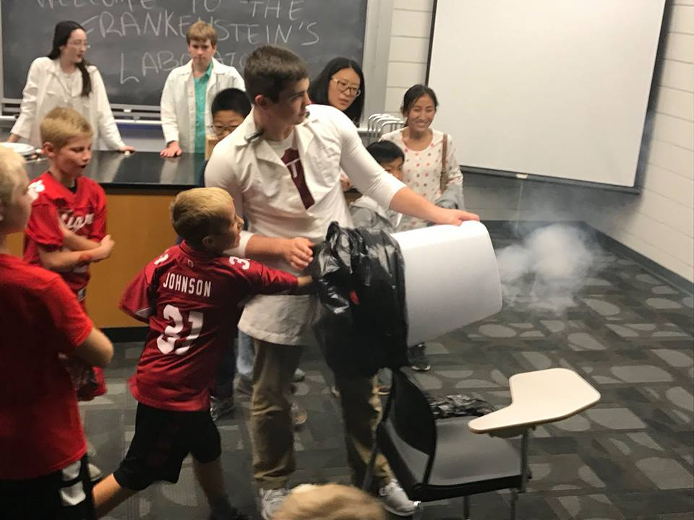
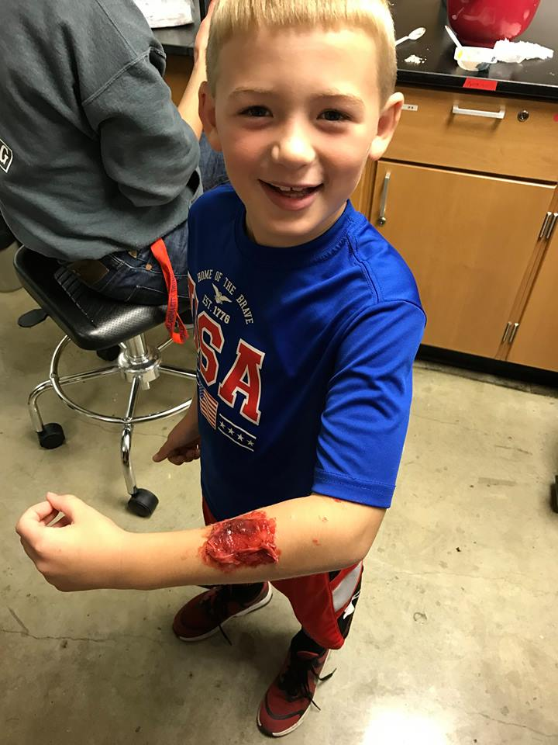
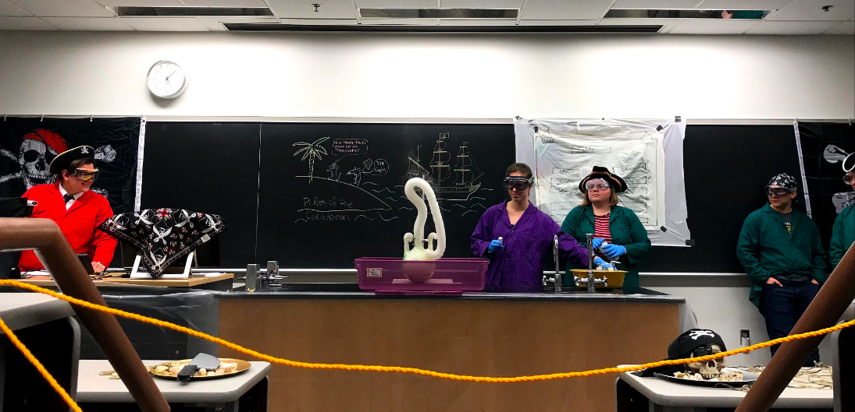
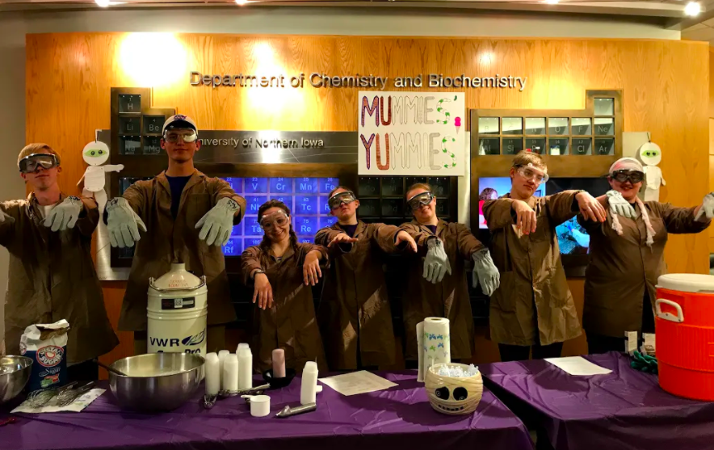
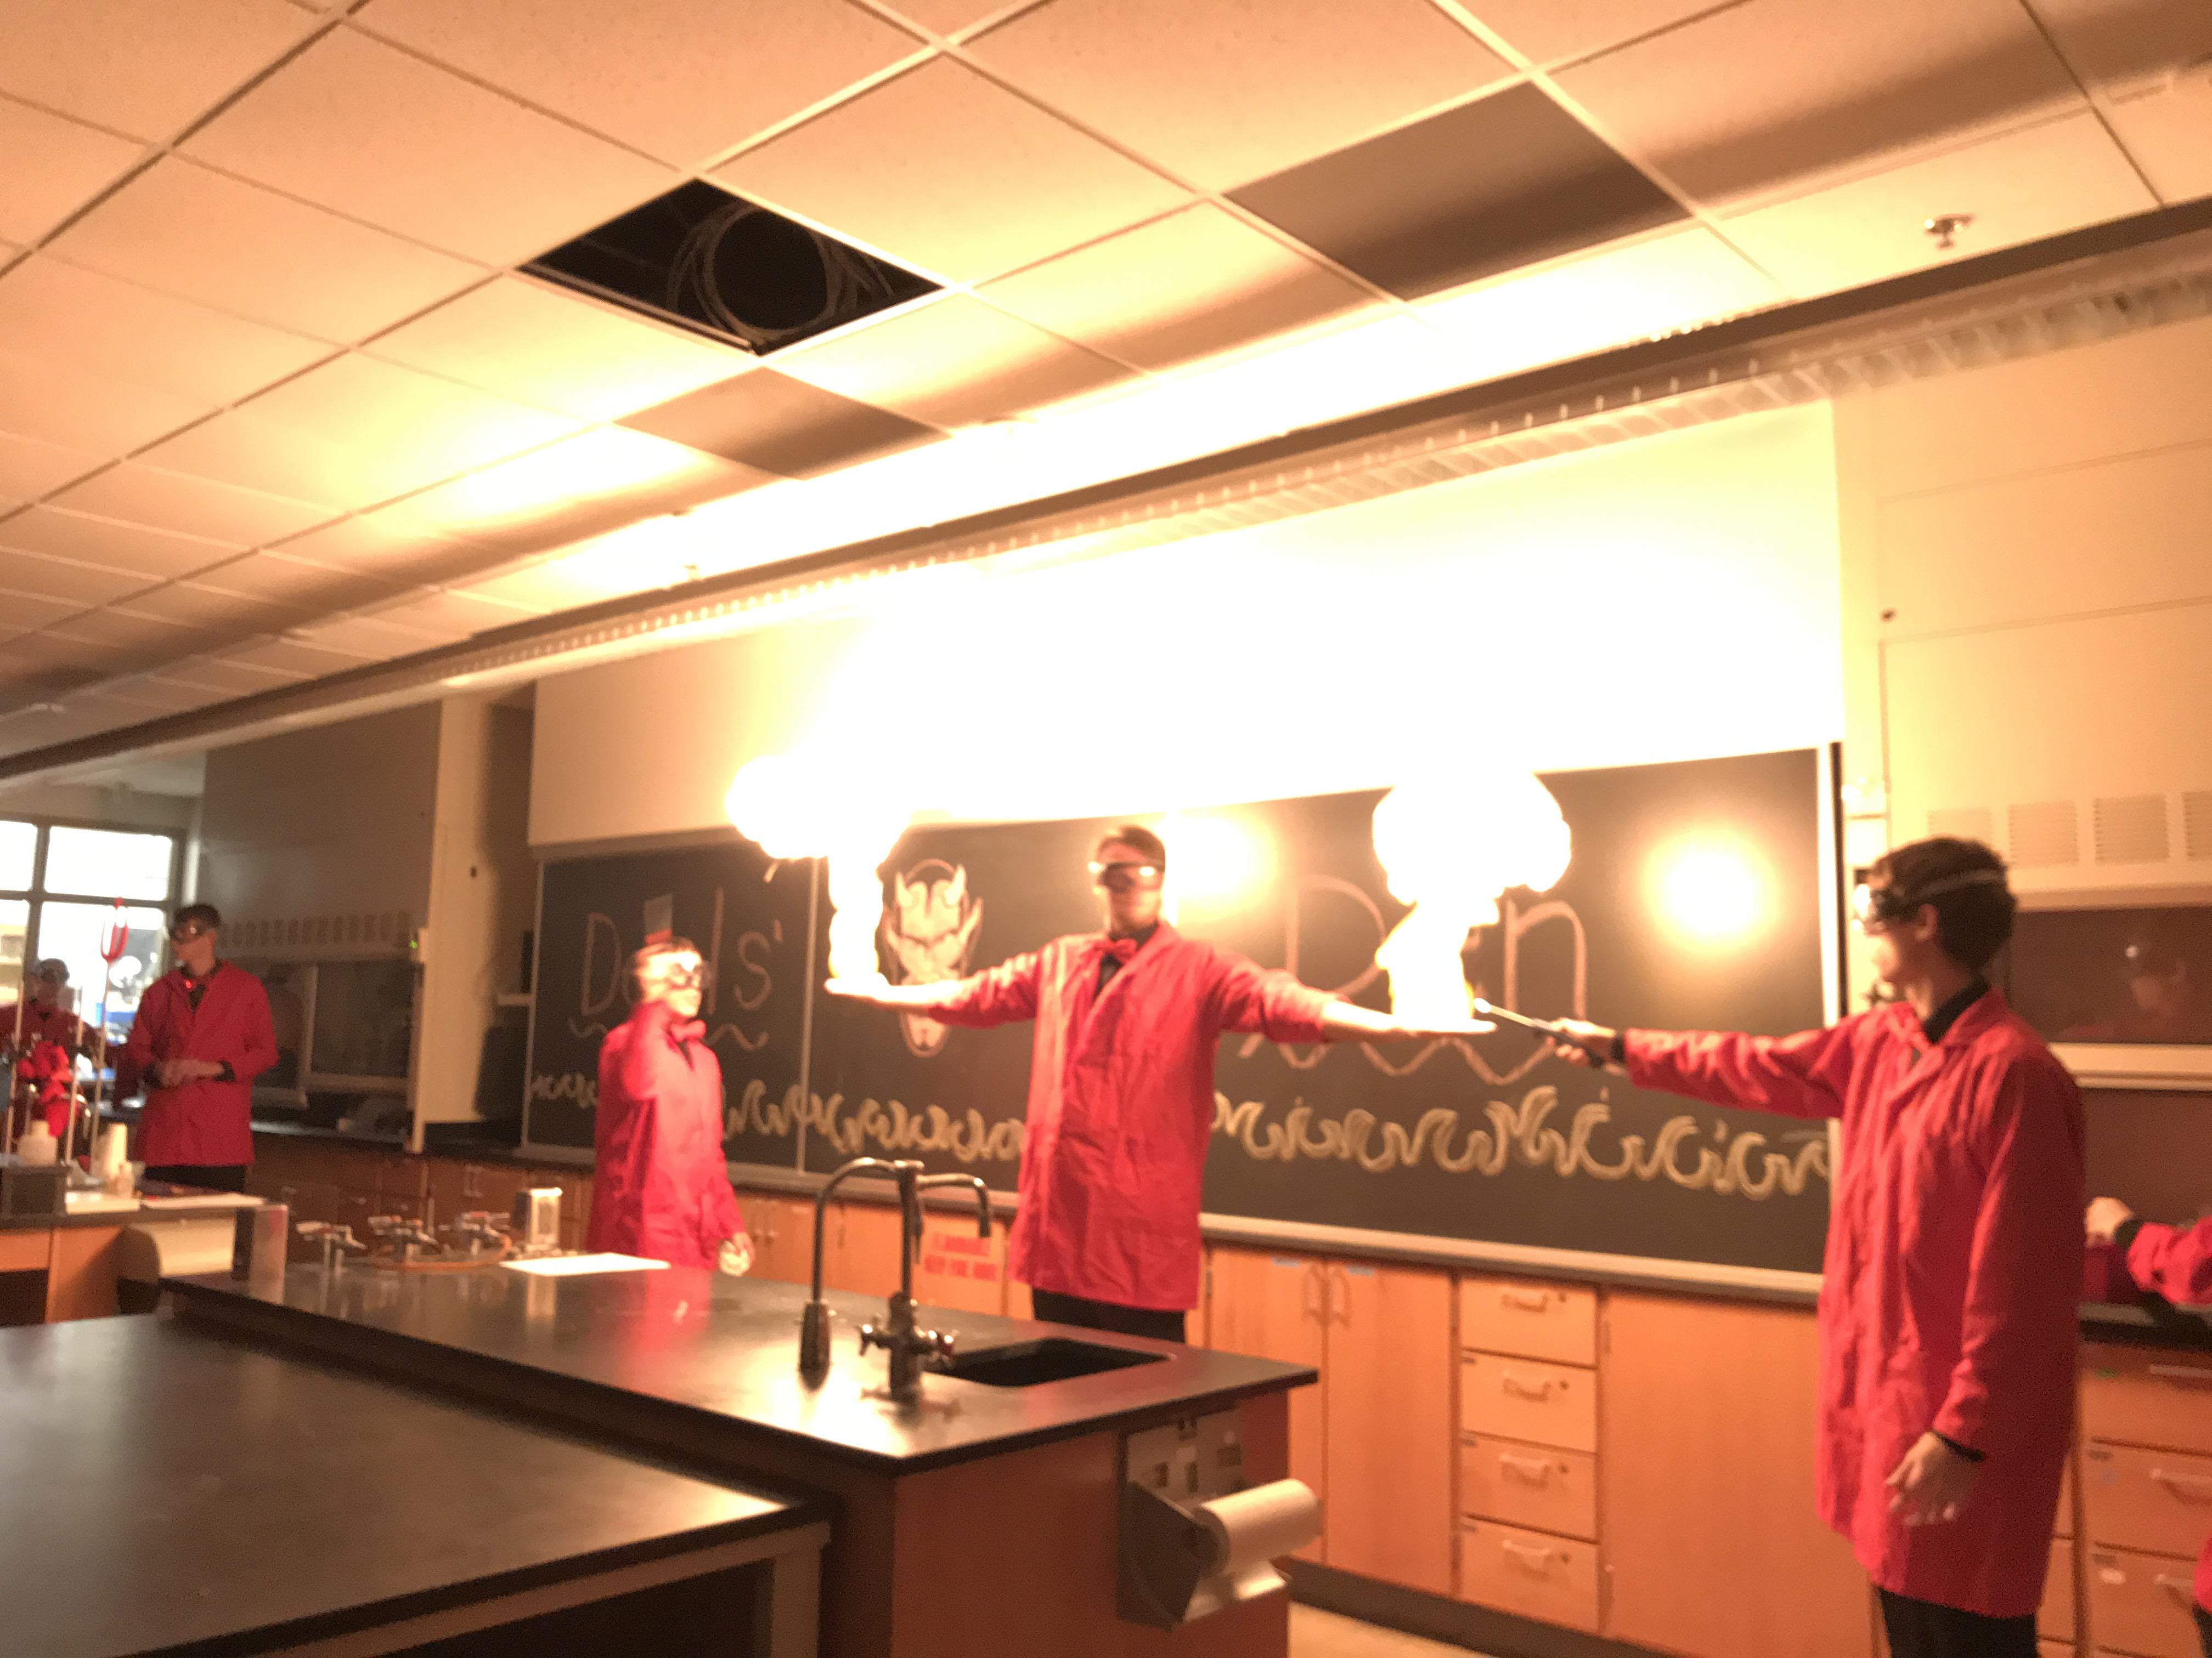
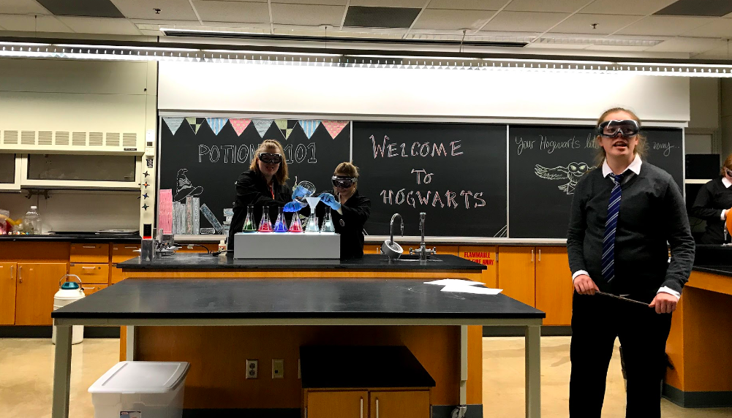
Halloween House
UNI Student Affiliates of the American Chemical Society
Department of Chemistry and Biochemistry
Introduction
STEM Clubs
Since 2007, the Student Affiliates of the American Chemical Society at the University of Northern Iowa has organized a community outreach program called Halloween House. What started out as a one-room chemistry demonstration show 11 years ago, has now evolved into a huge event in collaboration with other STEM clubs on campus. The event brought in between 800-1000 community members, mainly elementary aged-students, last fall. The collaboration amongst different STEM clubs in physics, biology, earth science, and chemistry allows students to have an interdisciplinary experience, exploring all of the sciences and seeing how they all connect. The Halloween House activities engage students with hands on activities and demonstration shows with captivating storylines that connect all of the demonstrations. Every room in the Halloween House event has a theme, for example, demonstrations involving fire are performed in the ‘Devil’s Den’ room. Approximately 35 college students partake in performing the chemistry demonstrations. Performing shows like these requires safety awareness and good communication skills on the part of the demonstrators. This is good practice for both future chemists and educators. For the audience, the demonstrations serve as an educational lesson in topics such as acid/base chemistry (rainbow connection), combustion and other exothermic reactions (lycopodium flame thrower), and intrinsic properties of different elements (flame test). After watching a demonstration, kids are asked to think critically about what they observed. After a couple of volunteers, the correct scientific explanation is given, completing the educational experience.
Other clubs that participate in the Halloween House event include:
BBB Biological Honors Society
  Wicked Ward
  Creepy Crawlies
Pre-Med Club
  Grossology
Physics Club
  Frankenstein’s Lab
UNI STEM Ambassadors
  Shadow Play
Sigma Gamma Epsilon (Earth Science)
  Triassic Terrors
TC & TK
Physics students show kids how to shoot the dry ice cannon at monsters hanging from the ceiling in Frankenstein’s Lab.
Chemistry Rooms
A young attendee shows off his fake forearm wound in the Grossology room.
Community Impact
The impact of Halloween House on the Cedar Valley may not be as direct or apparent as other events. The chemistry demos and STEM hands-on activities are a fun thing for the local children to do on a Friday night in their best Halloween costumes. Seeing their faces light up at the different flame colors in the flame test demo or hearing a small voice say “can you do that again?” after the methane bubbles demo is a huge benefit for the students running the shows. The community engagement portion of this event comes in the form of getting kids excited about science and STEM fields as young as three or four years old.
Showing kids how exciting it can be to be a scientist and the cool things you get to do when you study to become one is a great experience for our students. Our mission with this event is to get children interested in STEM and keep them interested as they enter high school and college. We also want to emphasize that learning and researching for fun is a good thing and that it is a trait that should be fostered in all children, not just those interested in science. Putting on this event brings together the students, children, and parents in a positive and fun learning experience.
Pirates’ Cove
Elephant toothpaste, gold pennies, balloon cannons, dry ice poppers, treasure map, dry ice balloon
Mummies’ Yummies
Liquid nitrogen ice cream, dry ice root beer
Acknowledgements
Devil’s Den
Methane bubbles, fire tornado, lycopodium flamethrower, paraffin melt, methanol carboy
Witches’ Lair
Rainbow connection, flame test, crystal ball, liquid nitrogen demos, genie in a bottle
The Student Affiliates of the American Chemical Society would like to thank our faculty advisors, Dr. Colin Weeks and Dr. Martin Chin for their tireless efforts in helping us organize this show. We’d also like to thank the entire Chemistry & Biochemistry department faculty and staff for preparing all of our demos and assisting the night of the event. Lastly, we thank our student organization collaborators for their desire to participate in the event and show children different kinds of STEM fields.

